Slide 1

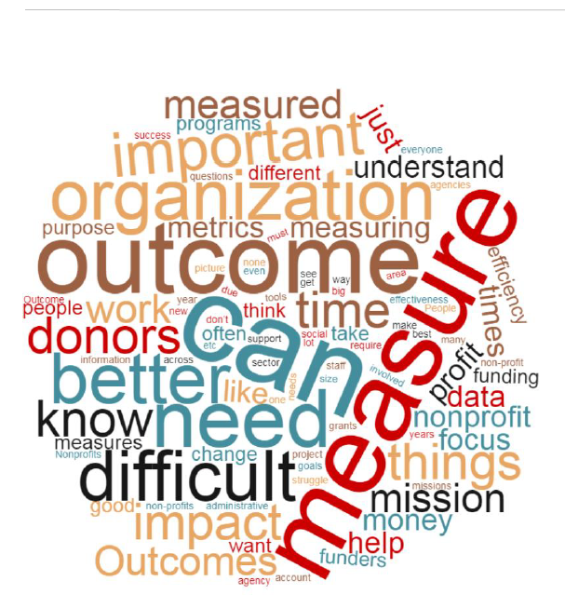
Connecting Dollars to Outcomes
2019 Nonprofit Research
Notes:
Customize title slide

Slide 2





Cheryl Gipson, Social Impact Product Manager
REMOVE AS APPROPRIATE
Industry Principal
Nonprofit
20
Years in Nonprofit Technology
5 Years
Director, Professional Services
Over 150 Implementations
2 Years
Product Manager
Consultant
Cheryl Gipson
cgipson@netsuite.com
5 Years
Solution Architect
Data Integration Architect
Notes:
Just a few quick words about myself. I’m a product manager in the social impact vertical at Netsuite and I’ve spent my career as well as sitting boards and as a volunteering. I’m deeply commited the sector and it’s success . I’ve been at Netsuite for 5 years and was part of a team of two solution architects who envisioned and prototyped the first version of NetSuite for nonprofits.
I also conceived of our nonprofit survey on measuring mission impact and am the author of our recent whitepaper on the topic – I’m excited to be presenting this webinar today as we tie in the research to digital transformation.

Slide 3




Fredrik Winsnes,
Director Center for Digital Nonprofit
REMOVE AS APPROPRIATE
Director
Center for Digital Nonprofit
25+
Years Technology Leadership
Mobile and Cloud Technologies
Kenya and Mozambique
Program Manager
Director of Technology
Microsoft
Notes:
Fredrik Winsnes is the Director for The Center for the Digital Nonprofit with NetHope. He previously was Senior Director in charge of NetHope’s Solutions Center.
Prior to joining NetHope, Winsnes spent a year with CARE International exploring the use of mobile + cloud computing technologies in Kenya and Mozambique.
Winsnes spent over 16 years with Microsoft in various management roles ranging from pre-sales activities through solutions and product development.

Slide 4
AGENDA
What does it Mean to Measure Outcomes?
Research Results: Nonprofits Share their Voice
Center for the Digital Nonprofit
Resources for you to Succeed
Questions and Answers
Notes:
So let’s jump in and talk about our time together today. I’m going to spend the first 5 to 10 minutes defining what it means to measure Outcomes and then move into our research results, where we’ll spend the bulk of our time. Then I’m going to turn it over to Frederik who is going to share with us his work at the Center for the Digital Nonprofit and how help us understand how digital transformation is a key component measuring outcomes.
Then I’ve got some next step resources and we will open it up for questions.

Slide 5
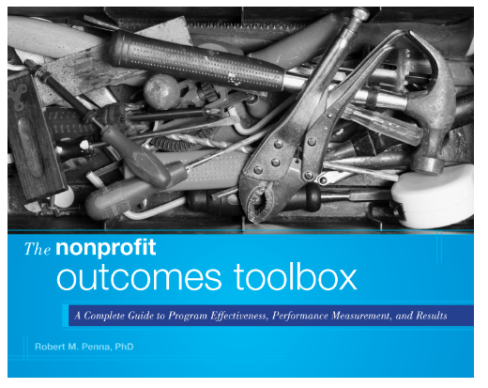
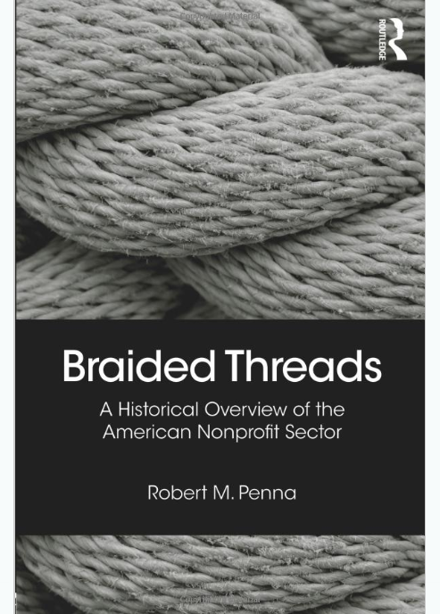
A Complete Guide to Program Effectiveness, Peformance Measurement and Results
Robert M. Penna, PhD
Notes:
So let’s level set here, and define Outcome Measurement. I’m using the definition from Robert Penna, an outcomes expert.

Slide 6
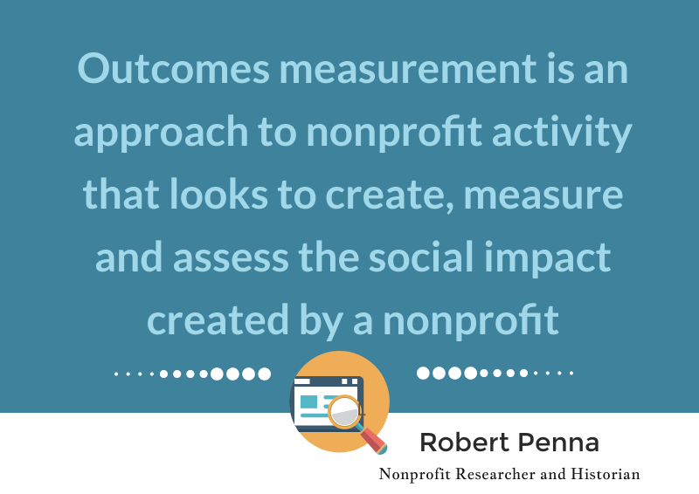
Notes:
Outcomes measurement is an approach to nonprofit activity that looks to create, measure and assess the social impact created by a nonprofit.

Slide 7
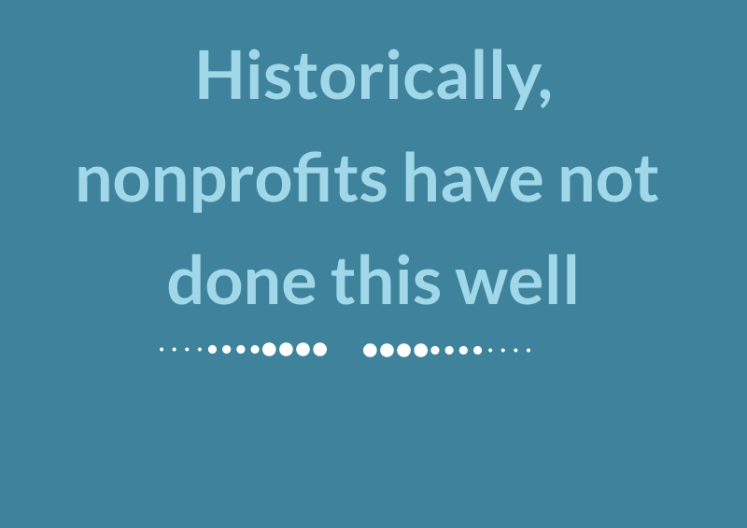
For most of our history we have not done this
Notes:
In his book Robert states that up to 20 years or so ago, nonprofits did not this very well.
Most nonprofits have focused on what they are doing, not how they have impacted change.

Slide 8
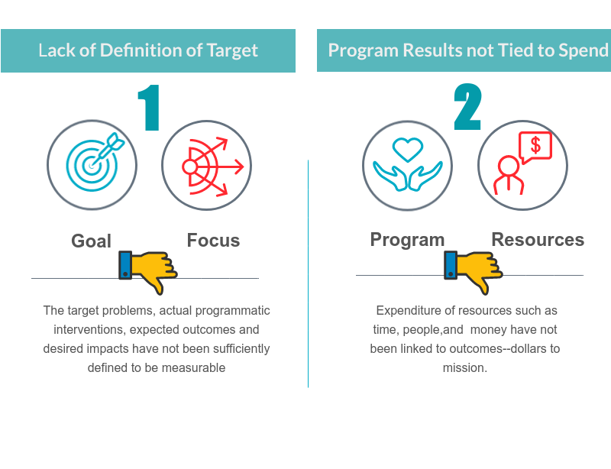
Notes:
He States there are two reaons for this:
1. Lack of definition
The target problems, actual programmatic interventions, expected outcomes and desired impacts have not been sufficiently defined to be measurable
2. Lack of clear program results tied to resource expenditure.
Expenditure of resources such as time, people,and money have not been linked to outcomes--dollars to mission.

Slide 9
Notes:
Use this slide to add text

Slide 10
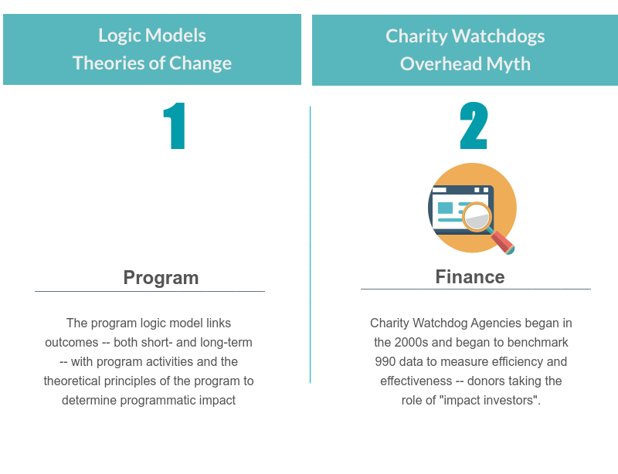
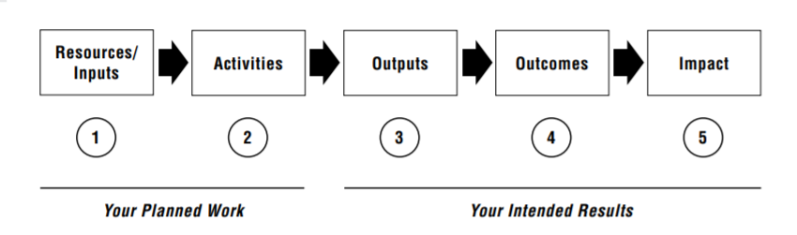
Notes:
Now, the way I see is that two trends have evolved in the past two decades
The first has to do with evaluation and programs
Formal evaluation of program delivery has been integral to demonstrating outcomes form when Kellogg Foundation began to develop methodologies with the United Way to fund, monitor and evaluate programs. The terms Logic Models and Theories of Change describe two common methodologies used to create programs and measure their impact. Logic models are used by program evaluation staff
but the second trend has to with financial evaluation of a nonprofit is and the last 15 years so we have seen the era of the watchdog agency, which has created an entirely different set of criteria for success, and some of it controversial with the conflating of low overhead for a nonprofit to mean a well run nonprofit.

Slide 11
Notes:
Now this is a lot to unpack, and I’m just setting the stage here to help this audience and readers understand our research study and the results.

Slide 12
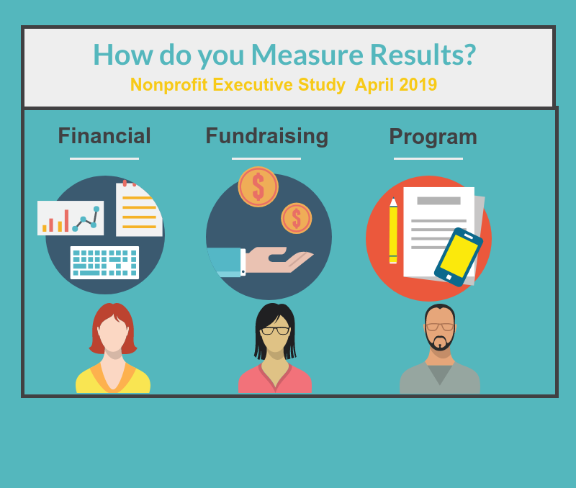
Notes:
And also to clarify that if you are a program person your understanding of outcomes might be quite different from your colleague sitting on the finance and operations side – and different still from the development officer sitting in cubicle next to you.
And part of my quest in this research was to find out from different areas within nonprofit organizations what they doing. Are they attempting to evaluate mission impact?. Are they using outcomes measurements to determine program effectiveness? Do they use Charity Navigator metrics? What works and doesn't when evaluating impact.
Quick raising of hands – how how many of you are in finance, how many are in fundraising? How many in program? I know from my organizational work that different areas within a nonprofit have very different focus – they use different tracking systems and these systems are generally not connected.

Slide 13
Poll
Program
Fundraising
Finance
Funder

Slide 14

Survey Results
Notes:
So let’s dive into our survey and our survey results

Slide 15
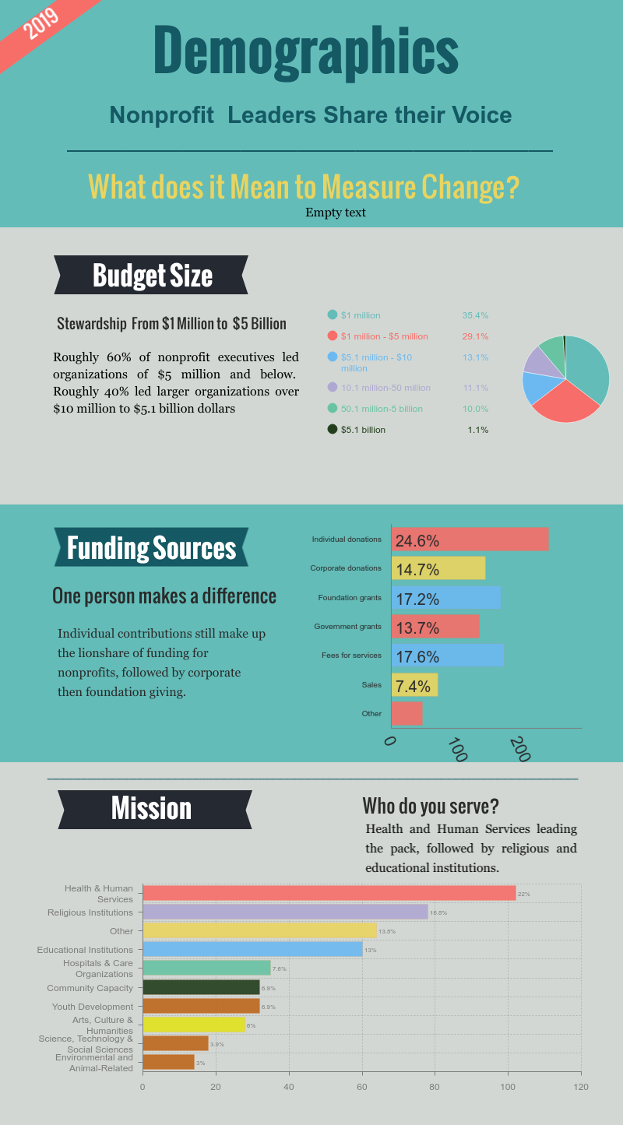
Survey completed in April 2019 by FINN Partners
353 Decision Makers
Range of
  Budget Sizes
  Missions
  Funding Sources
Notes:
Our big idea was to find out - What does it really Mean to Measure Change?
We worked with a research firm and approached 353 nonprofit decision makers to ask if and how they evaluate outcomes. There was a battery of about 15 questions and it touched on the two facets and trends of outcomes measurement – program and finance.
A little bit about the demographics.
In terms of budget size rough 60% of nonprofit organizations interviewed have budgets of $5 million and below. Roughly 40% led larger organizations over $10 million to $5.1 billion dollars
Funding sources – most indicated that they were supported primarily by individual contributions, but also foundation and government grants as well as fee for service
Missions were also varied but led by health and human services, but educational institutions, arts, environmental and other youth development organizations.

Slide 16
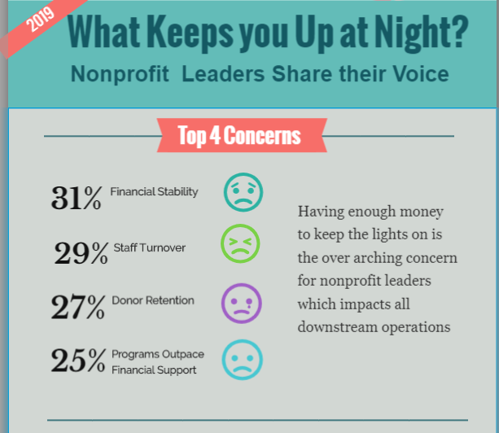
Notes:
So our first question was probing how relevant outcomes measurement was to their top concerns, and you’ll see that what keeps nonprofit leaders up at night is not the details of mission impact.
It primarily has to do with the financial stability of their organizations – you see that first followed by staff turnover, donor retention and then the last concern which IS about program delivery and the concern that the financial support might not be there.
This is an important frame of reference.

Slide 17



Especially for project-oriented nonprofits, outcomes measurements make sense so that donors, potential donors, and stakeholders can understand how a project is going and if the project is operating as planned.
Outcomes measurement requires a lot of data to become information. Things like surveys are incredibly important. And being able to write them to allow for non-bias answers continues to be a struggle across the board.
Often times donors - particularly charitable foundations - are too focused on short-term outcomes, without taking into account that often times it takes years to affect change.
Notes:
So let’s dive into some of the commentary –I want to call out a few statements – that are reflective of multiple survey participants – such as measurement requires a lot of data to become information – and foundations can be too focused on short term outcomes that can take years to affect change.

Slide 18

There are a lot of external factors affecting success and individual agency outcome measurement can't account for the cross-sector nature of this work. For example, my org runs preschool and after school programs, but our families' access to healthcare, housing, food, jobs, etc. all have a direct impact on children's success. And NO nonprofit should be relying on things like administrative efficiency or fundraising efficiency for outcomes measurement -- www.overheadmyth.org
Notes:
And then I do want to read this one as it’s relevant to a set of questions that we asked regarding watchdog agency metrics. Here’s what a survey participant said:
And then I do want to read this one as it’s relevant to a set of questions that we asked regarding watchdog agency metrics. Here’s what a survey participant said:
What she is referring to here is
A term coined by rnonprofit esearchers Ann Goggins Gregory and Dan Howard to describe the vicious cycle created when nonprofits underreport administrative costs to secure funding and then run into deficits, creating the need for more funding
Open Letter from GuideStar, Charity Navigator, and the Better Business Bureau Wise Giving denouncing the ‘overhead ratio’ as a stand alone indicator of nonprofit performance”

Slide 19
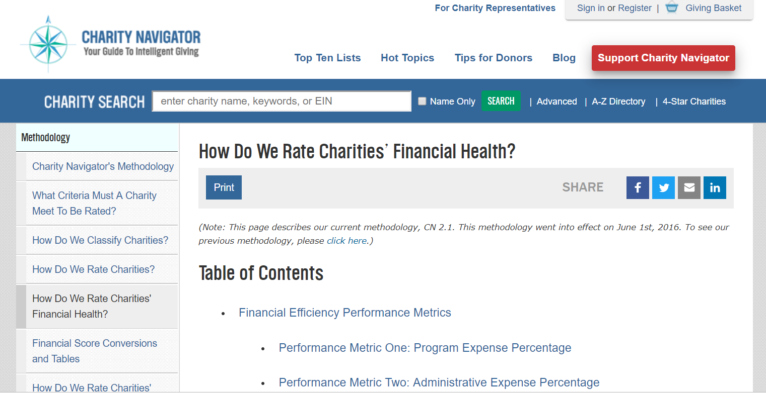

Is Charity Navigator on your Radar?
Notes:
So one of our biggest questions for decision makers was their awareness of Charity Navigator metrics
We rate charities by evaluating two areas of performance: Financial Health and Accountability & Transparency. Our ratings show donors how efficiently we believe a charity will use their support today, how well it has sustained its programs and services over time, and their level of commitment to being accountable and transparent. We provide these ratings so that donors can make intelligent giving decisions, and so that the philanthropic community can more effectively monitor itself.
Financial Health
We base our evaluations on the financial information each charity provides in its informational tax return, the IRS Form 990. We use that information to analyze a charity’s financial performance in seven key areas that assess its financial efficiency and financial capacity, in relation to its cause area. We then assign the charity a score ranging from zero to ten in all seven performance metrics, as well as a rating for its overall Financial Health.
Accountability & Transparency
To evaluate an organization’s Accountability & Transparency, we utilize two sources: information available on the organization’s 990 and information collected from a review of the charity’s website. We use that information to score an organization on seventeen metrics that assess whether it follows best practices of governance and ethics, and whether it makes it easy for donors to find critical information about the organization. We then assign a rating for the organization’s overall Accountability & Transparency.

Slide 20
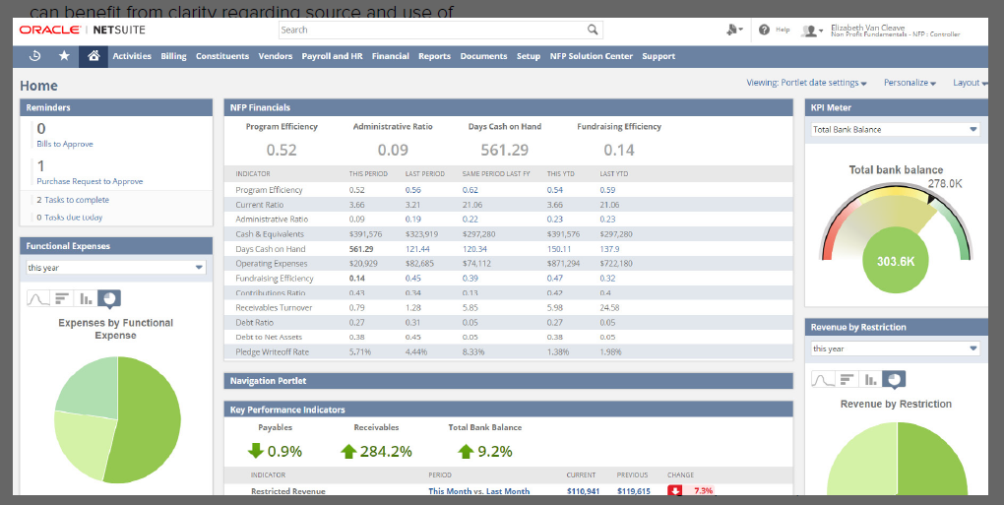
Do you Measure? Do you think it’s Important?
Financial Efficiency
Metrics

Slide 21
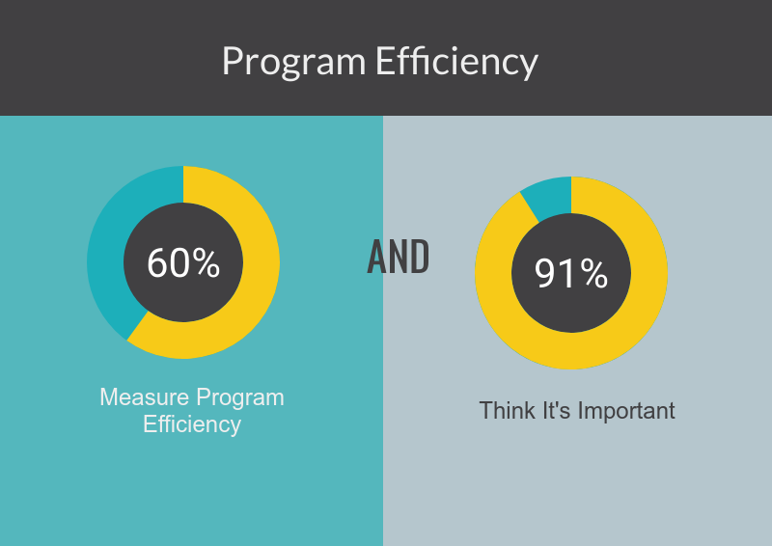
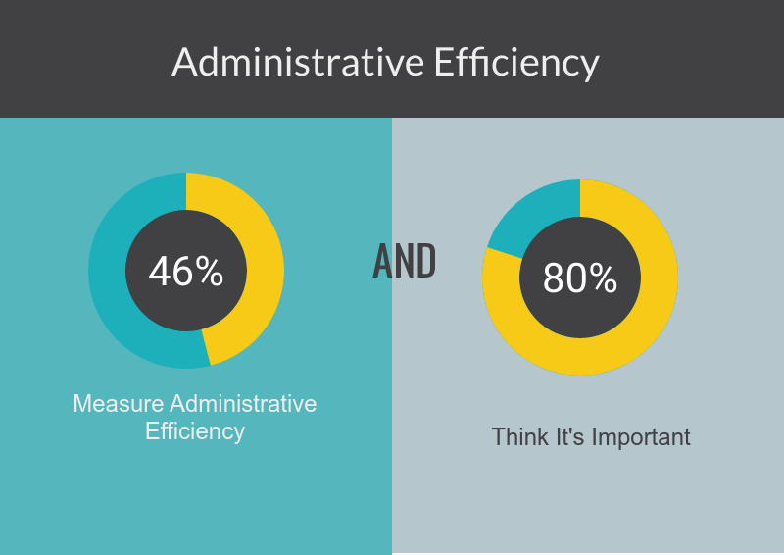
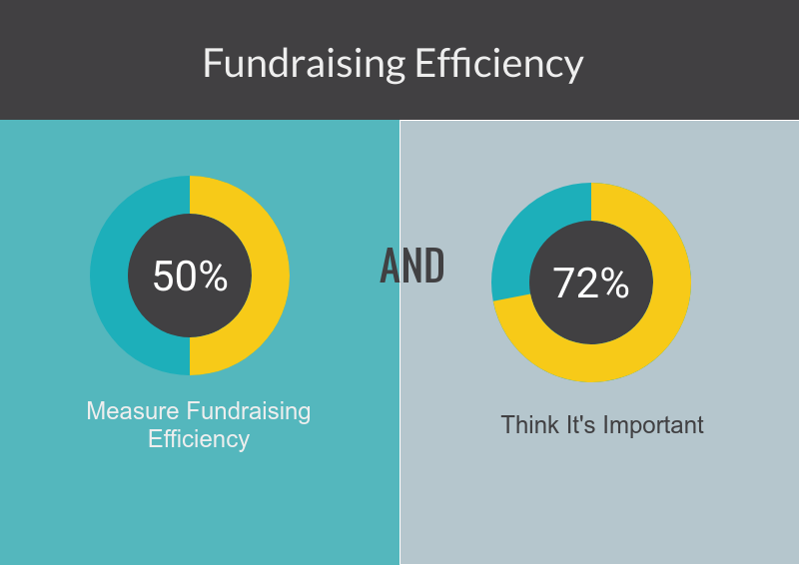
Financial Efficiency Metrics

Slide 22
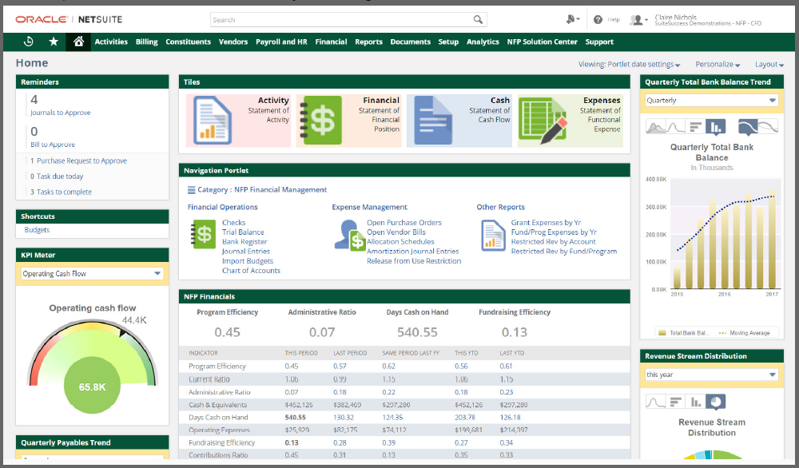
Do you Measure? Do you think it’s Important?
Financial Capacity
Metrics

Slide 23
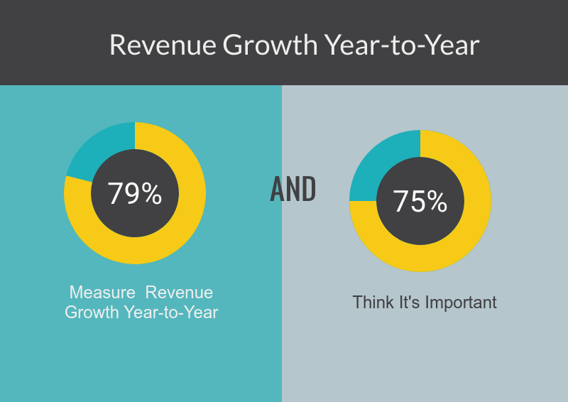
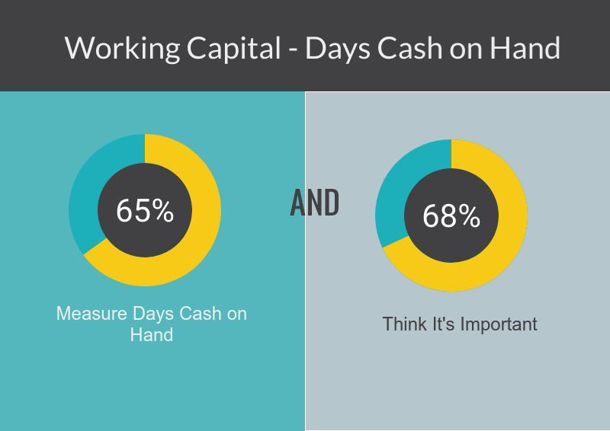
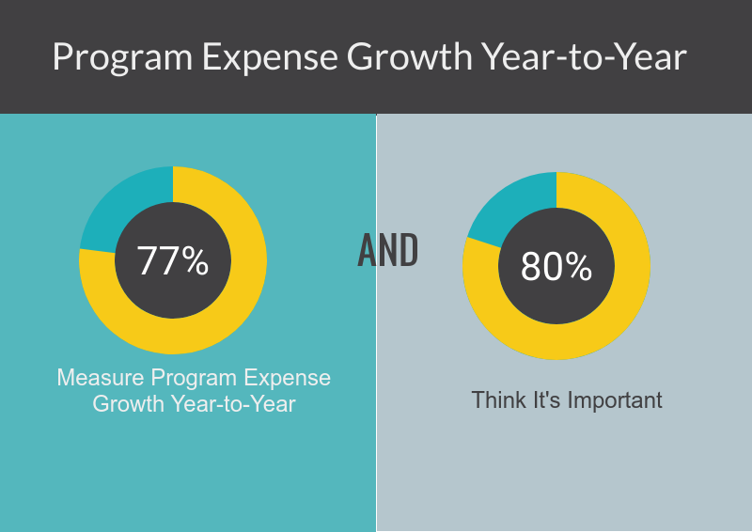
Financial Capacity Metrics

Slide 24
What do you Measure Beyond Finances?

Slide 25
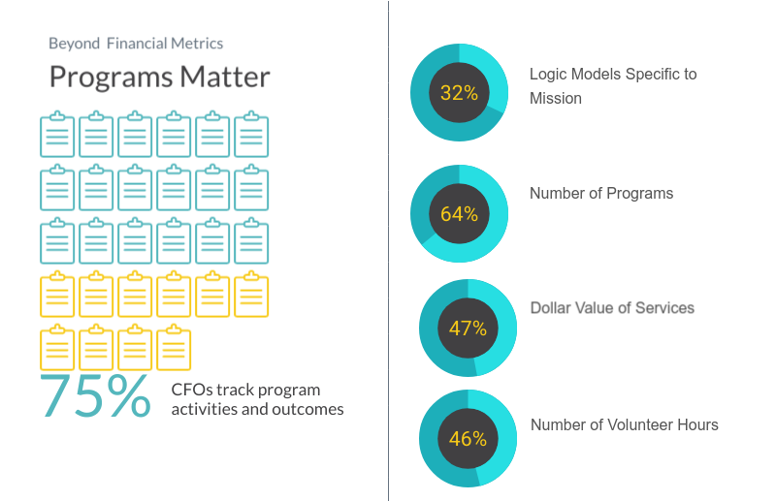

Slide 26
What are your Challenges?

Slide 27
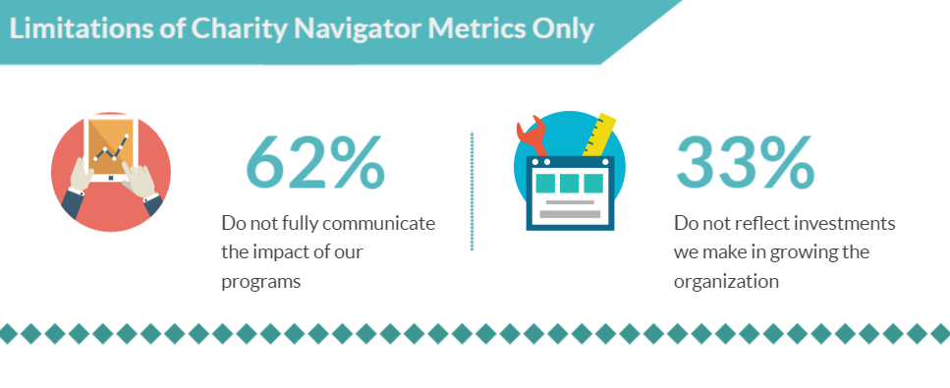

Slide 28

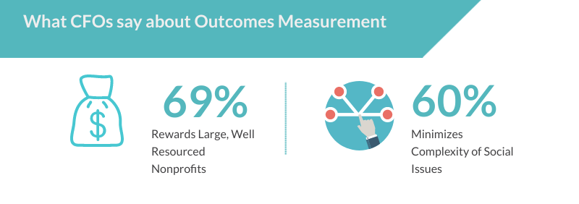
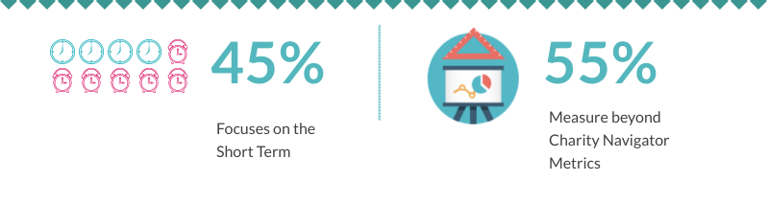
Notes:
I want talk a little bit also about some of the opinions that people shared. Almost 70% of the organizations said that they felt that larger organizations were in a better position and better advantaged in measuring outcomes.
And frankly 45% said they felt that outcomes measurement was short term thinking and 60% said it reduced the complexity organizations faced. Now from the perspective of the finance people – 55% said they measured beyond Charity naviagor metrics

Slide 29
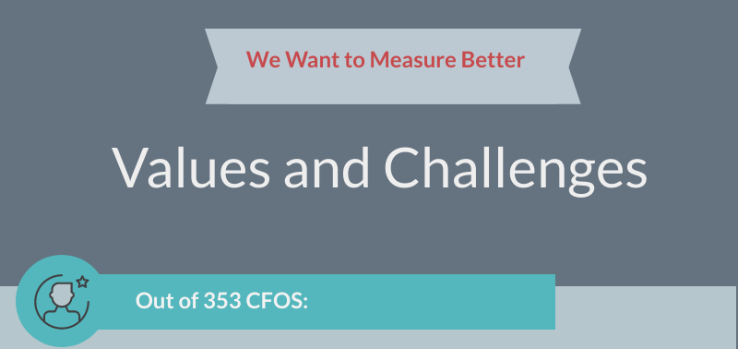
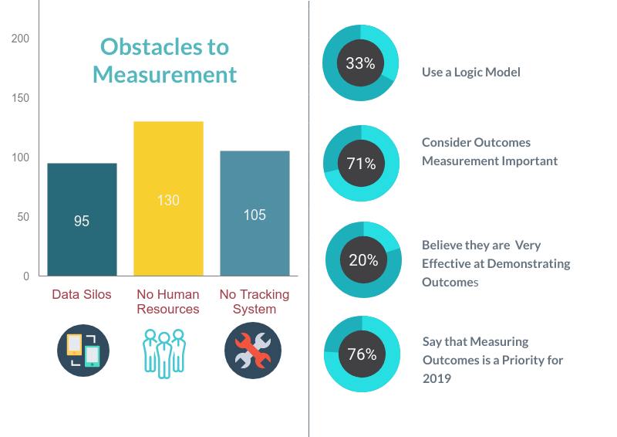
37%
27%
30%
Notes:
1st is data silos – I think anyone who works in a work nonprofit knows what I’m talking about here. Tehse are different systems that different areas use and all the anciallary spreadsheets and hidden areas of tracking.
The next which is the high amount is lack of reasources – there is non on the team who is accountable to measure.
And last 30% say there’s tracking system at all. So how can you measure when you have nothing to measure with.
Just a few more things I want to point out – is that is that we did ask about program measurement approach and you’ll see a similar pattern which is that the respondents felt that programmatic measurement was important, but not many were actually using those methods of measurememt.
For example, only 30% were using logic models and yet 70% said they considred outcomes measurement important. 20% said they thought they were effective in outcomes measurement, yet 75% said it’s a priority.
My takeaway here is that organizations re well intentioned – they want to be able to identify where they are headed and track how they’re getting there but there are genuine reasons that they get stuck.

Slide 30
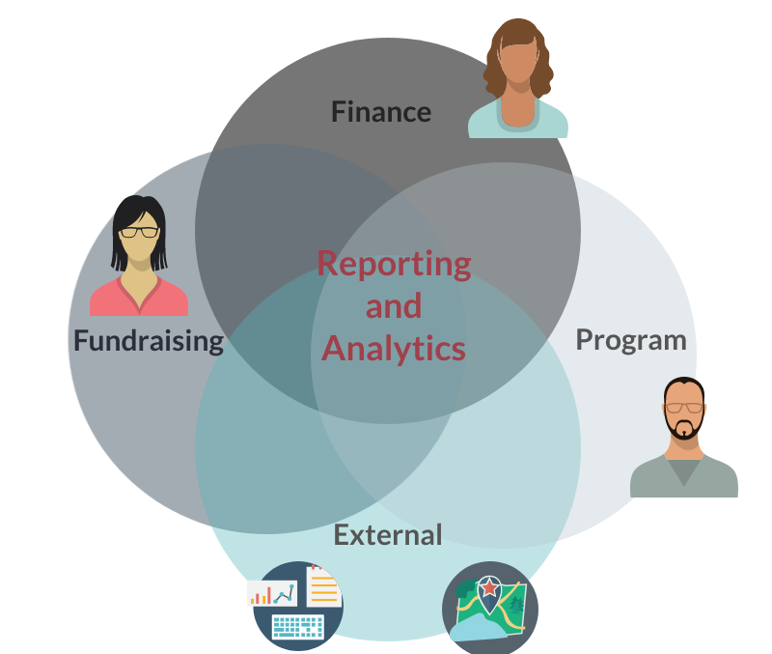

Notes:
So the last slide here represents the different departmetns within a nonprofit – it’s tricky to get the reports, do the anlaysis to course correct? Why because we have data living in different areas that has to come together to give us the 360 view.

Slide 31
Center for the Digital Nonprofit
Notes:
DOING GOOD BETTER
The Center for the Digital Nonprofit pulls the future forward so that international nonprofits can do good better.
Through innovation and collaboration, The Center brings together the expertise of the technology sector with the on-the-ground experience of global nonprofits to create a network for committed, forward-looking organizations to help global nonprofits accelerate the advancement of their missions and achieve exponential impact to improve the world we share.
By providing the guidance, resources and tools, and grantmaking needed for digital transformation, The Center helps nonprofits achieve the promise of tomorrow today.

Slide 32
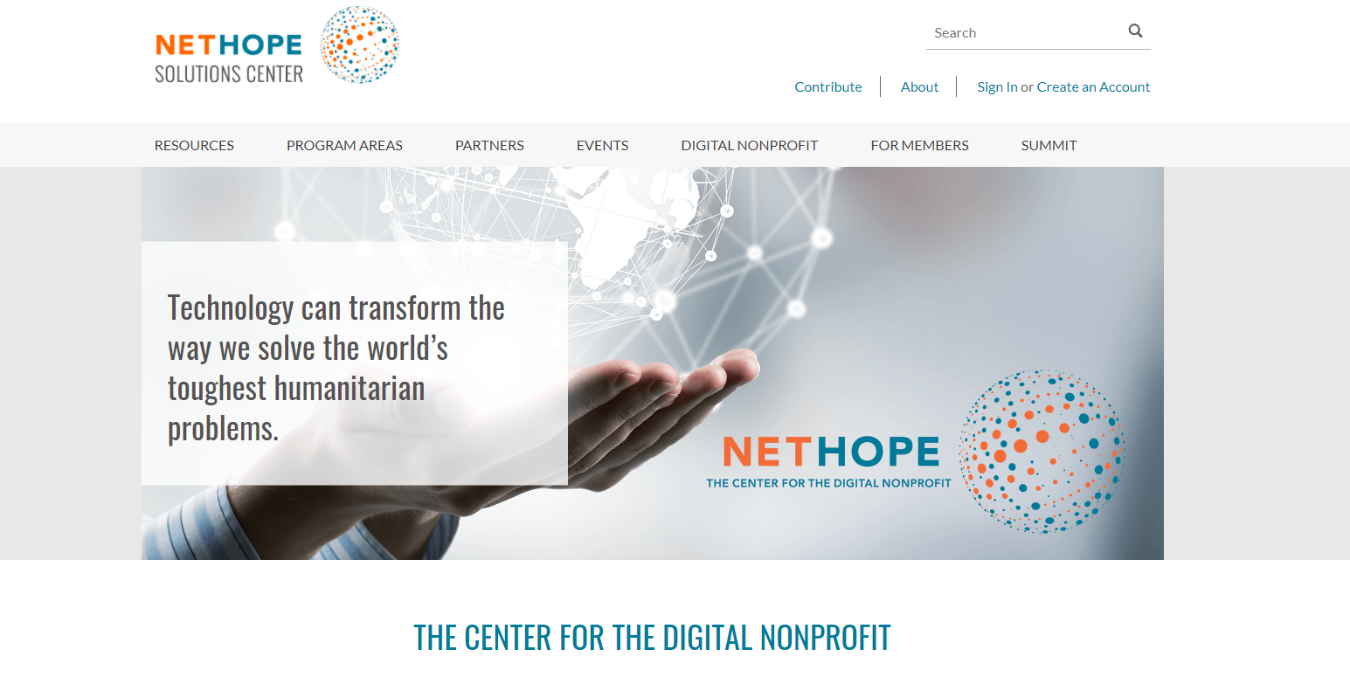

Slide 33
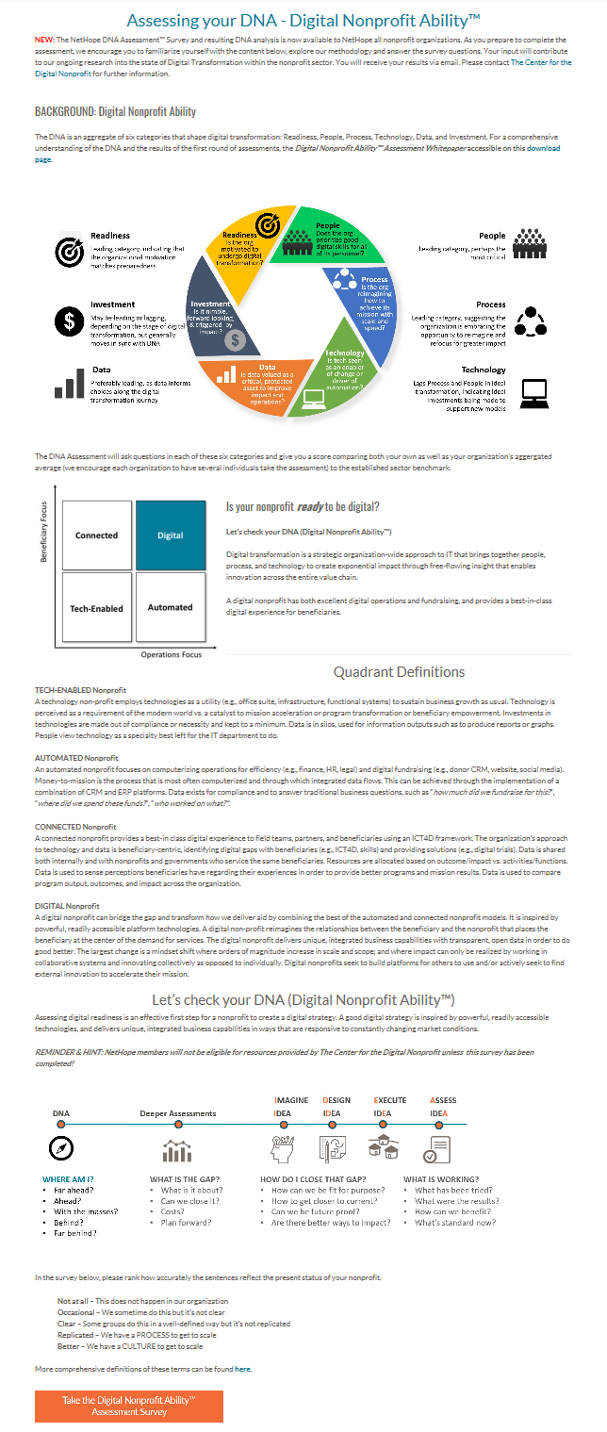
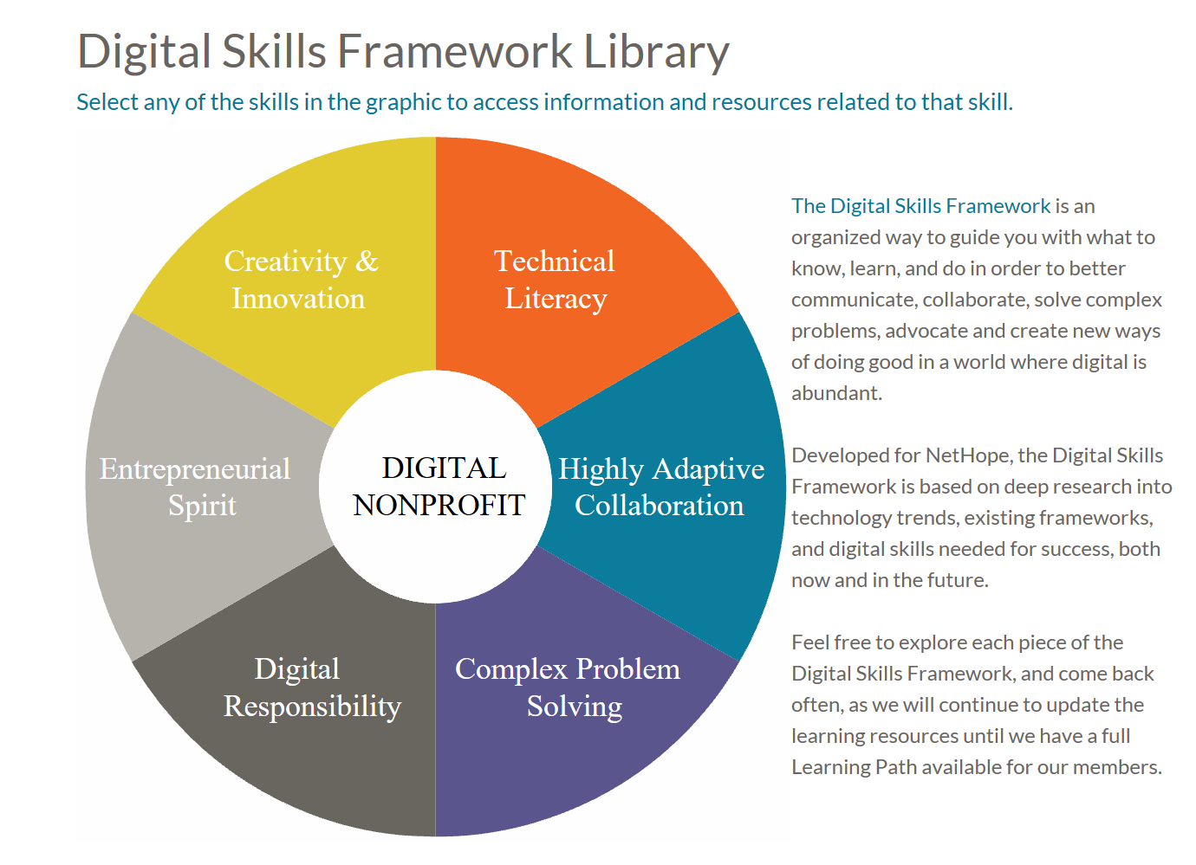
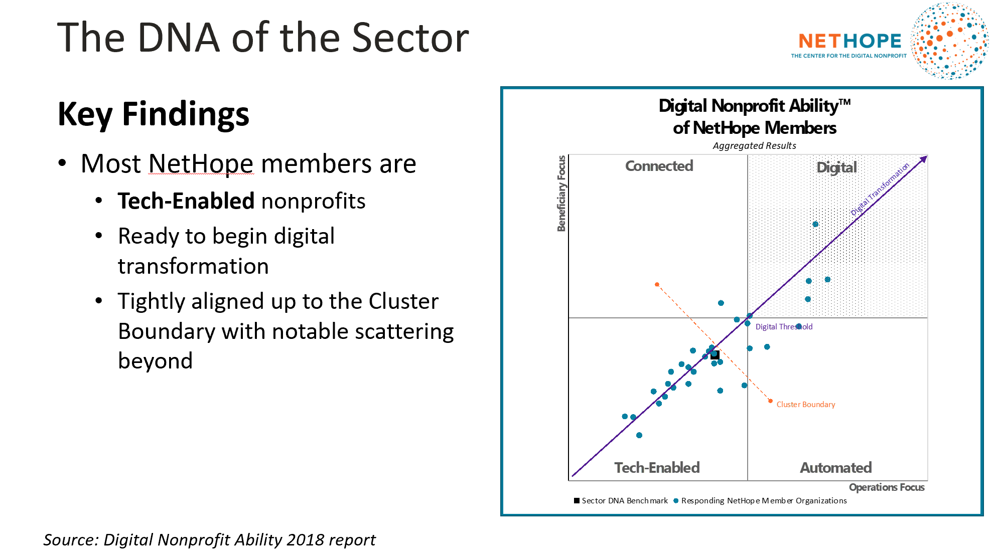
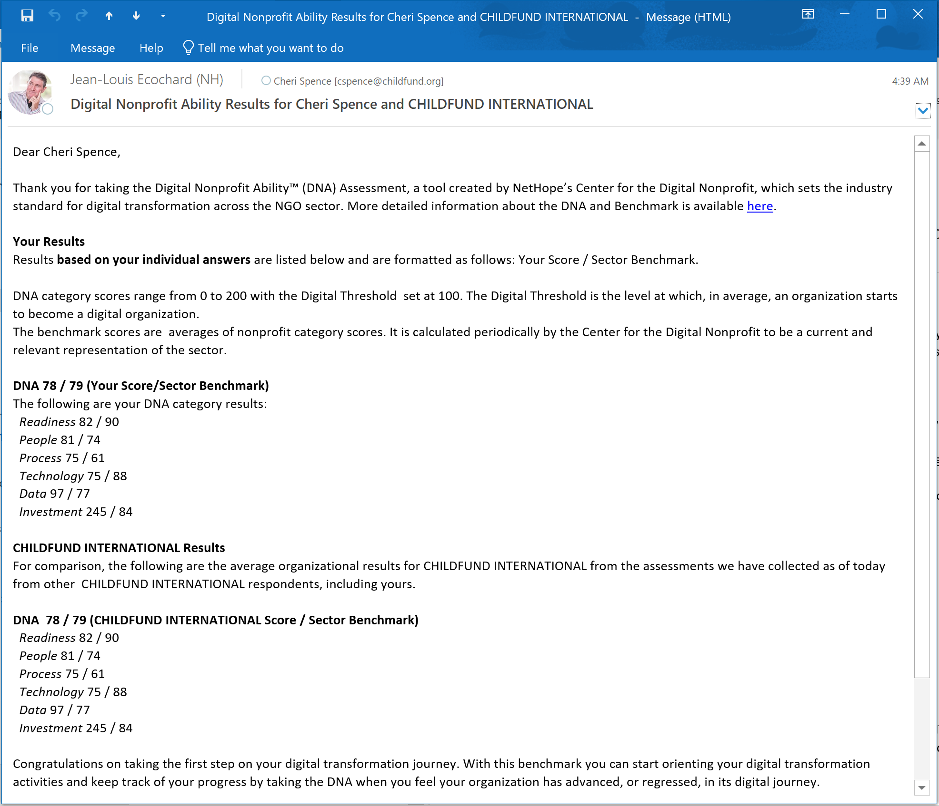
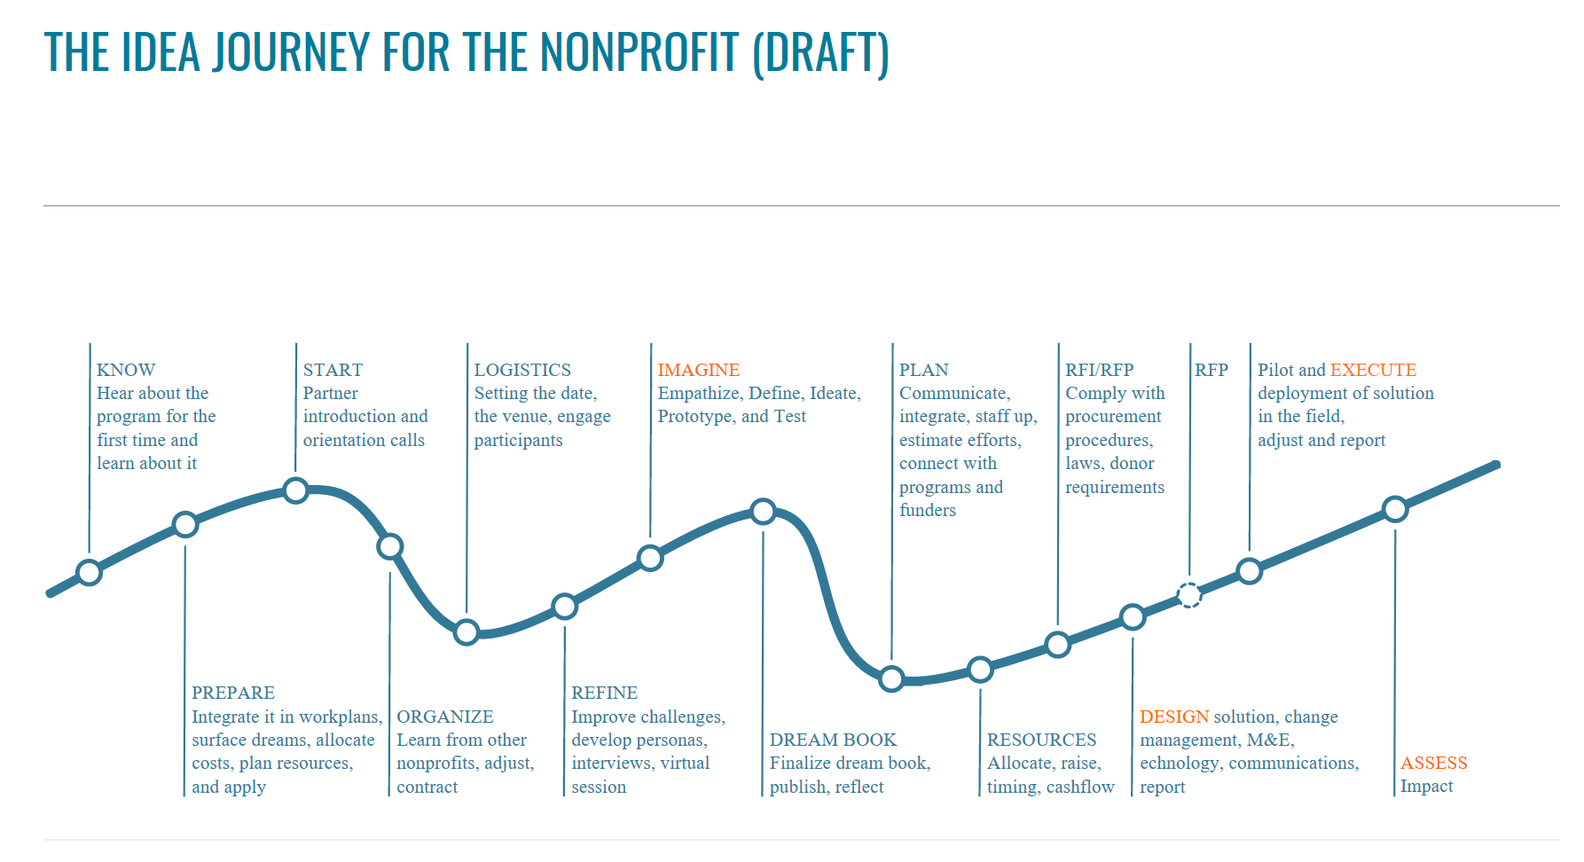
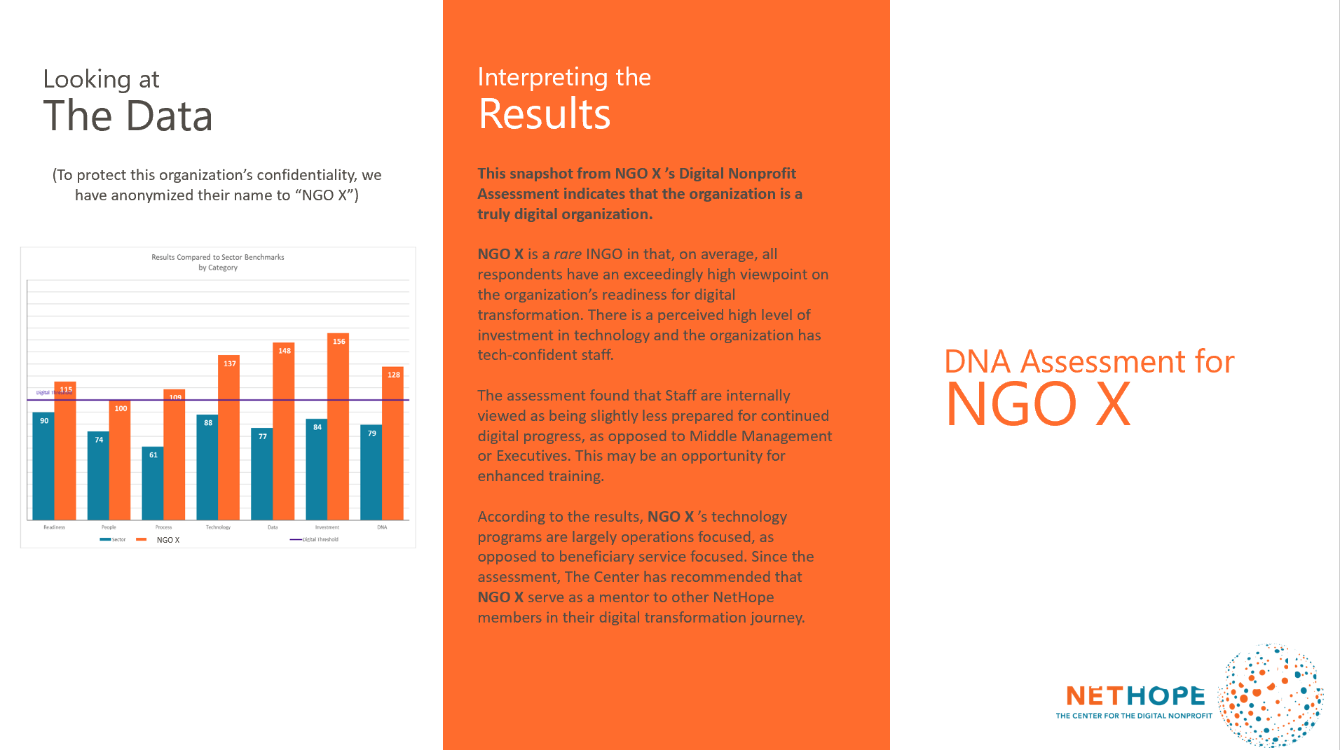
Starting Your
Digital Transformation Experience
DNA Assessment
  Start Page
  Survey
Email notification
  Individual & Organization DNA Scores vs. Benchmark
  Link to Landing Page
Landing Page w/Offers
  Deeper Analytics
  Recommendations
  Earned Revenue
Digital Transformation:
  “Personal”:
  Digital Skills Framework
  “Organizational”:
  IDEA Journey

Slide 34
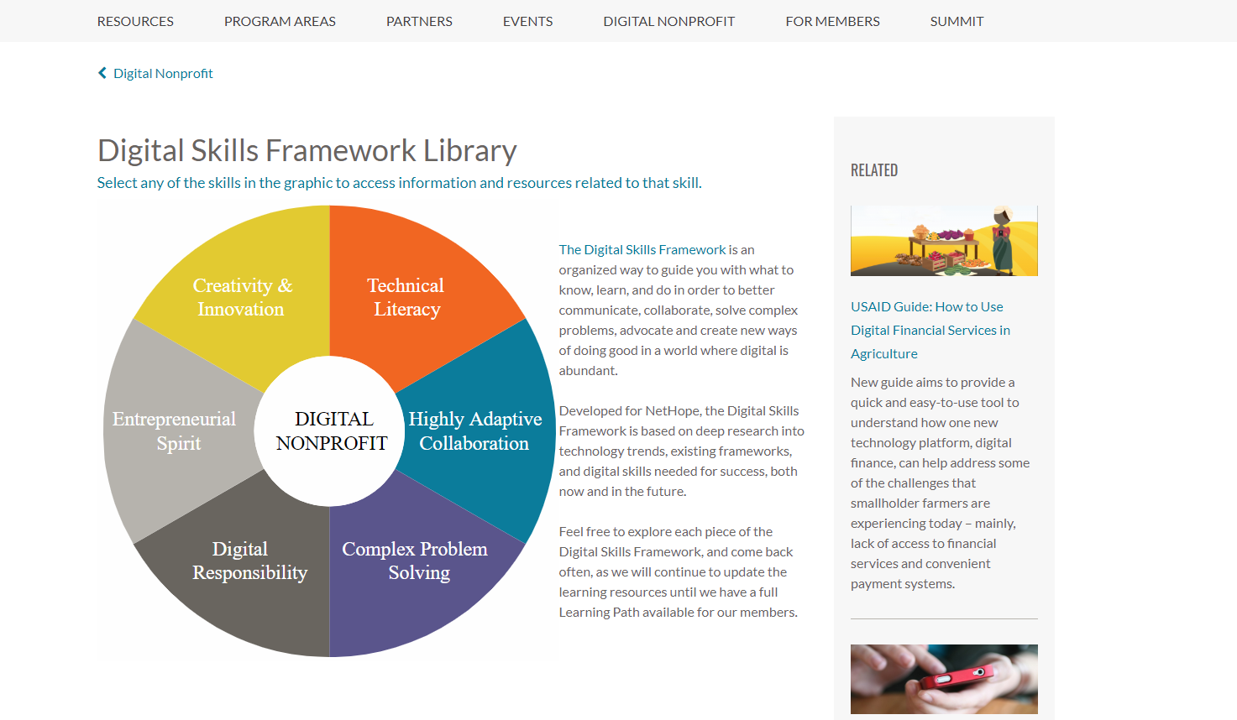

Slide 35
Resources

Slide 36
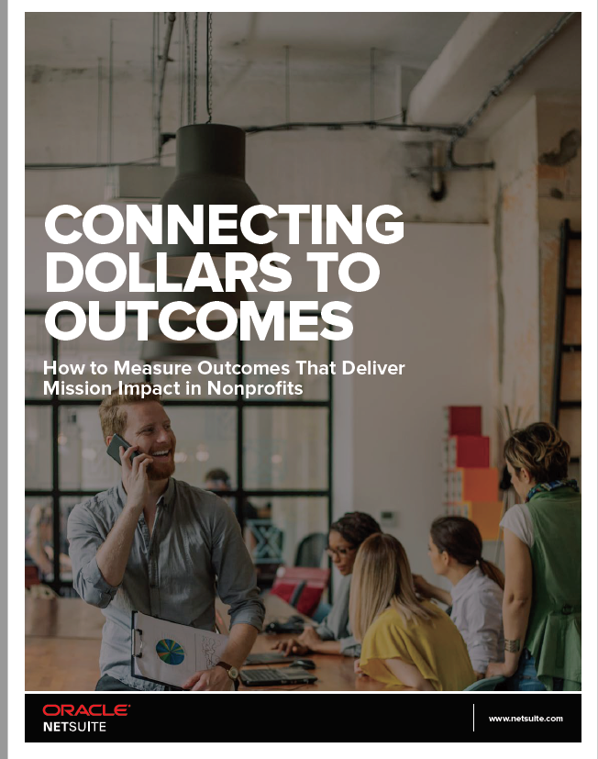

Slide 37
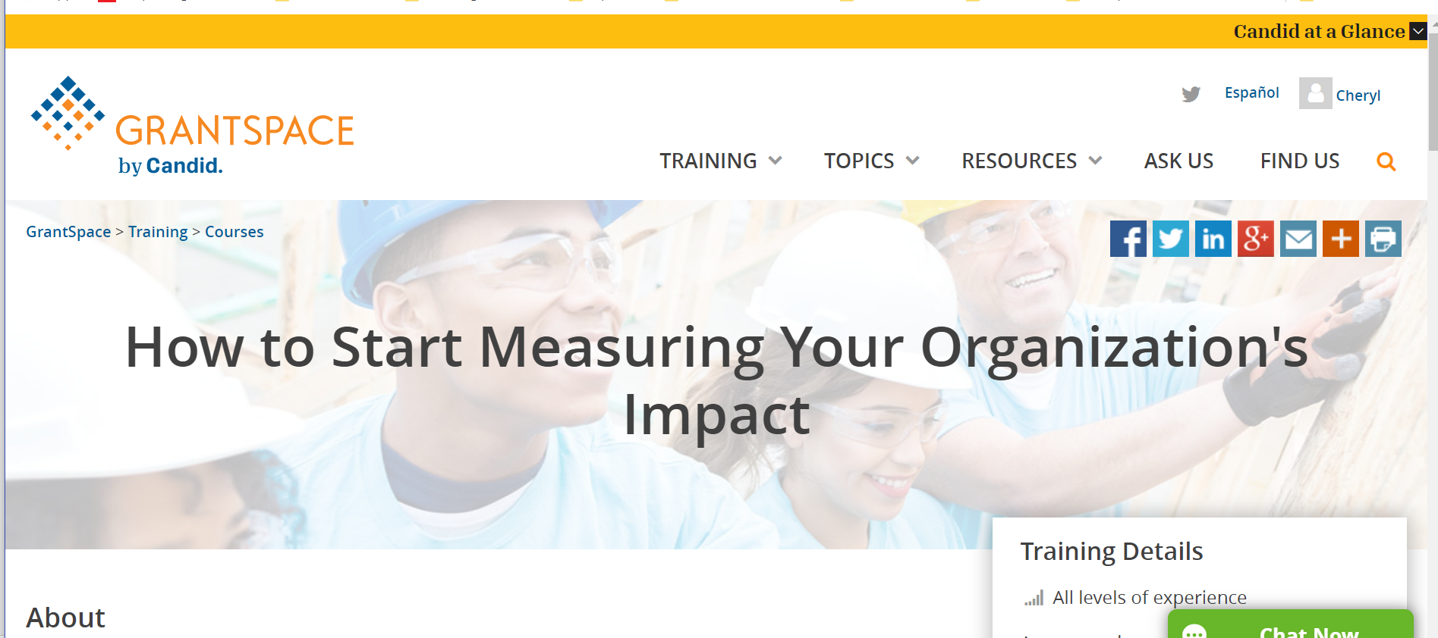
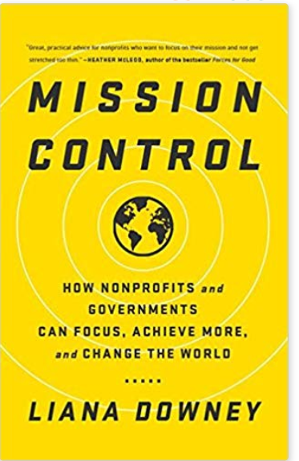

Slide 38
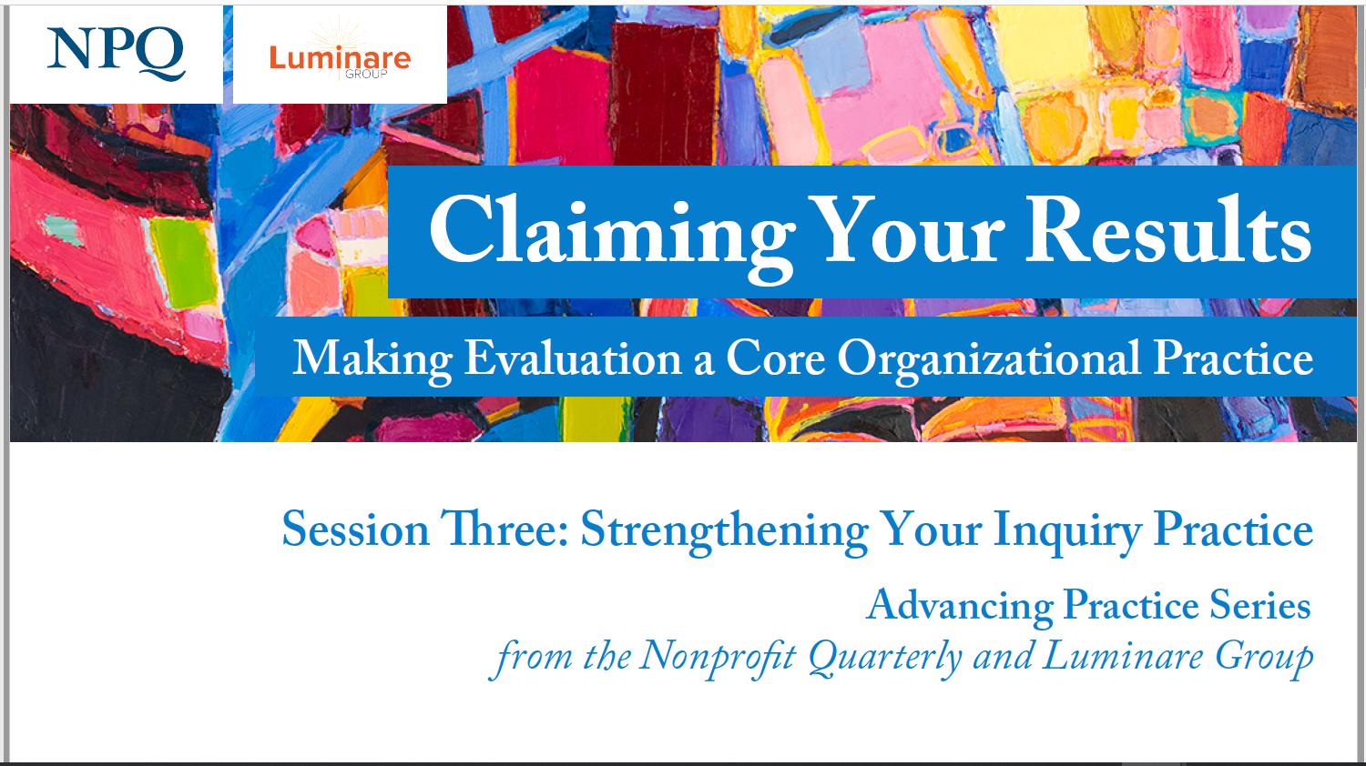

Slide 39
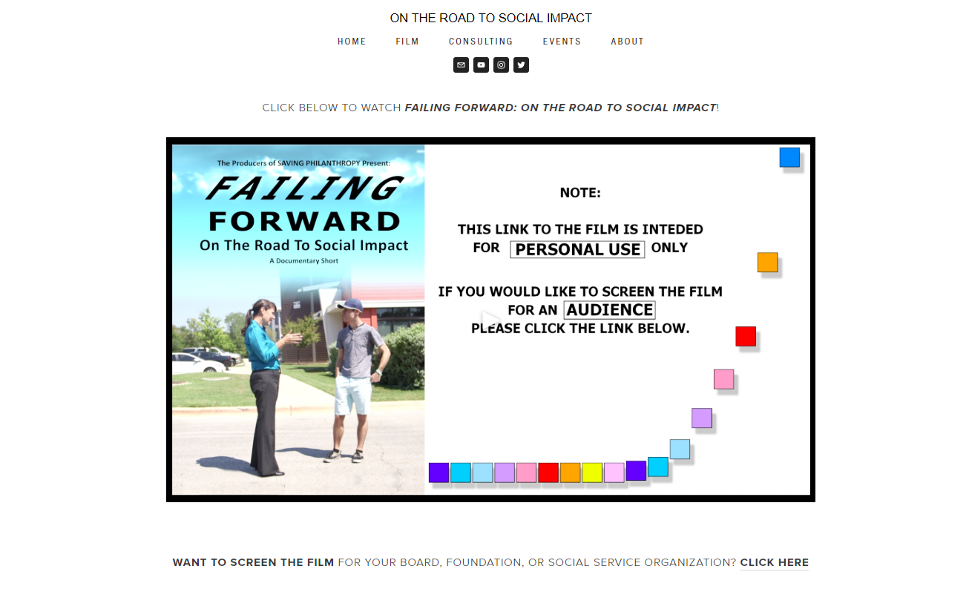

Slide 40
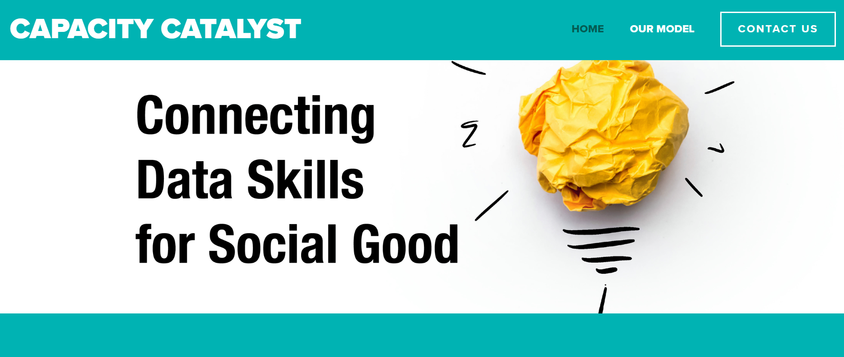

Slide 41
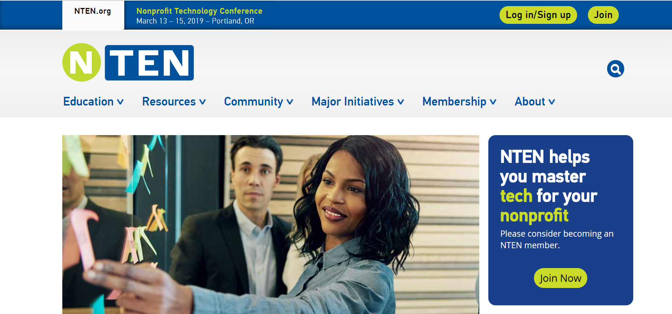
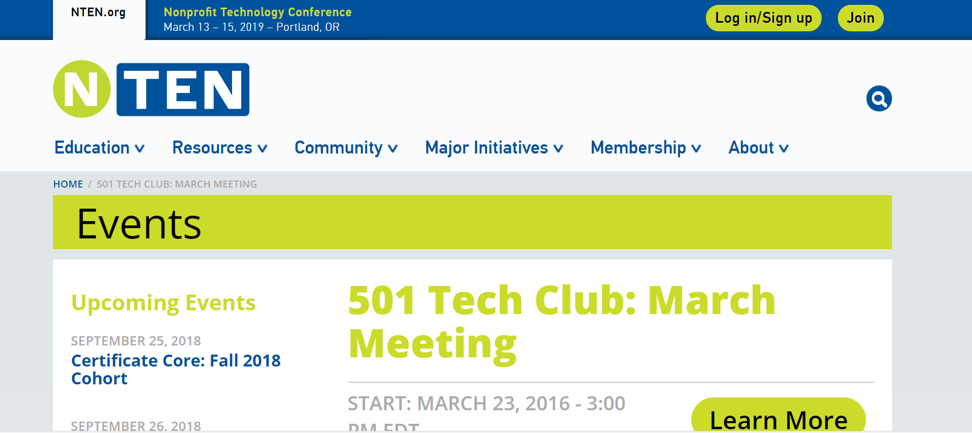

Slide 42
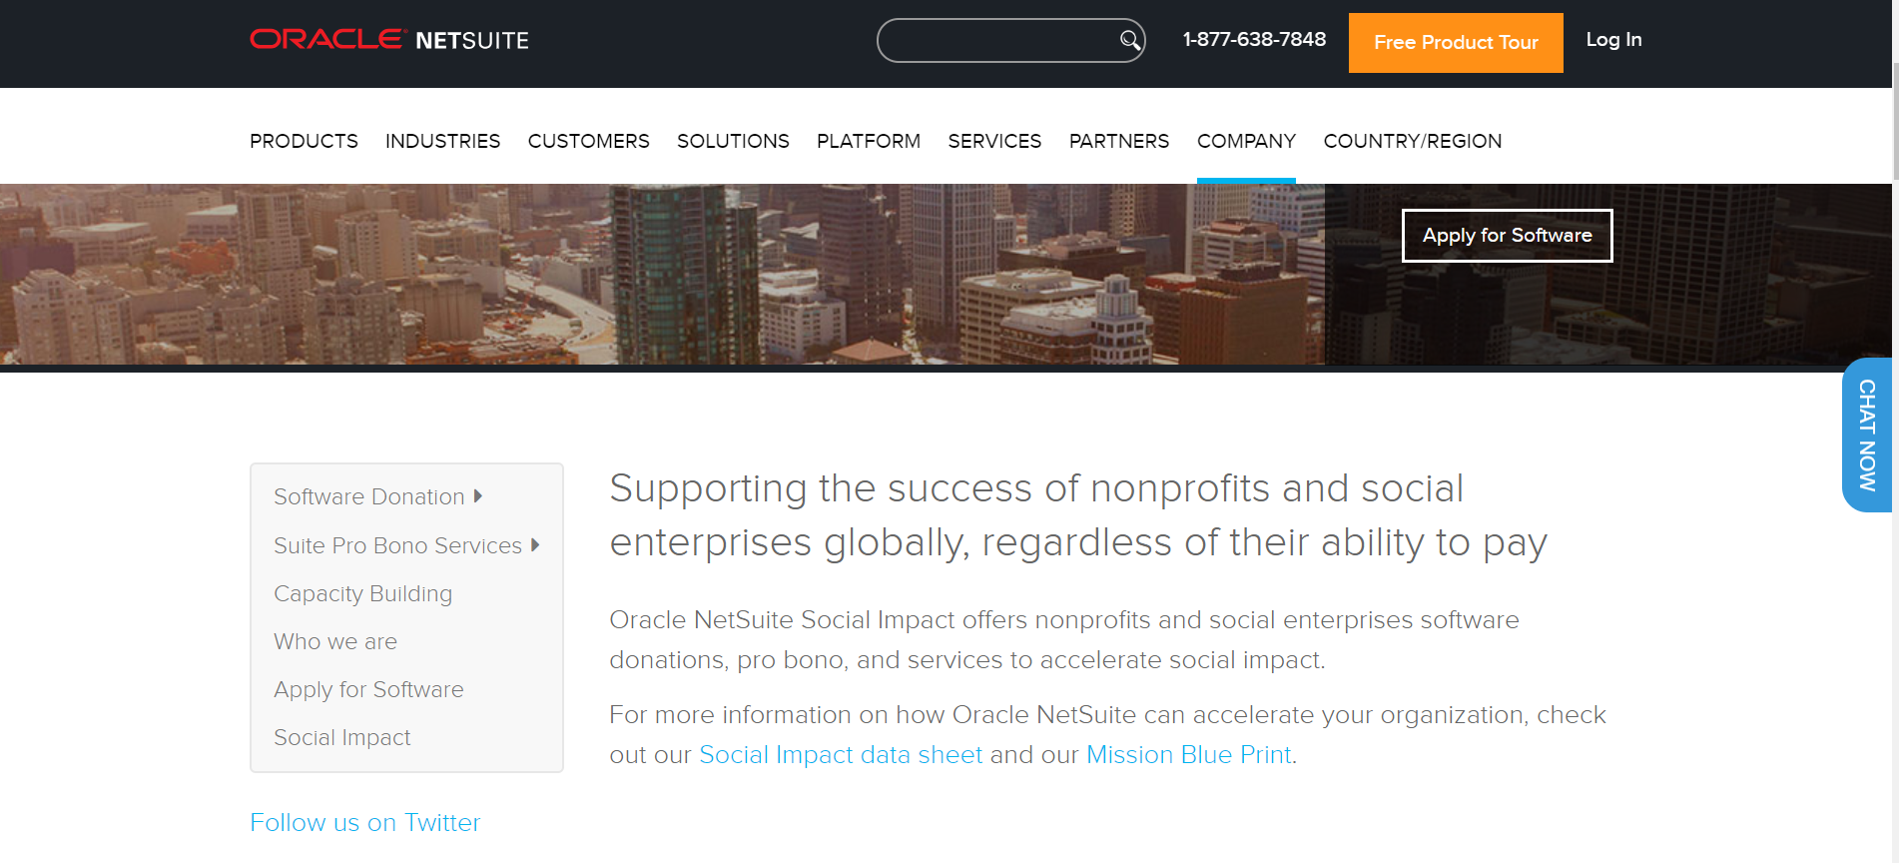
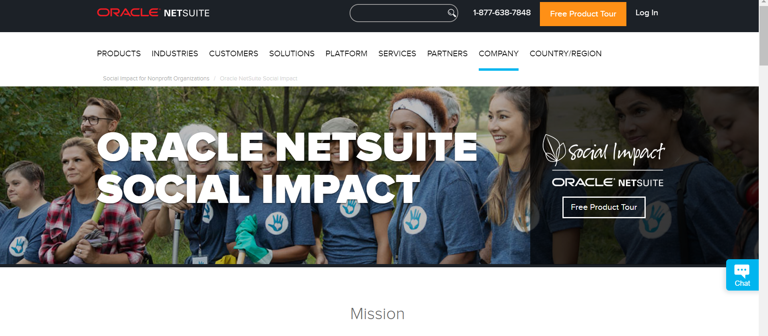

Slide 44
Q&A

Slide 45
THANK YOU

